Slide 1
Project 1: Interim Presentation Treatment Responses to HAART in Multicenter AIDS Cohort Study
Rachel Johnson
BIOS 6623

Slide 2
Data Summary
Research question:
How do treatment responses after 2 years differ between subjects who report using hard drugs and those who didn’t?
Primary predictor
Hard drug use at baseline (Yes (n = 467) vs. No (n = 39))
Covariates selected by investigator
Baseline: outcome value, age, BMI, alcohol use (13 or fewer vs. >13 drinks), smoking status (never/former vs. current), income level (<$10,000, $10,000-$40,000, >$40,000), education (HS or less, >HS)
2 year: ART adherence (>95% vs. <95%)

Slide 3
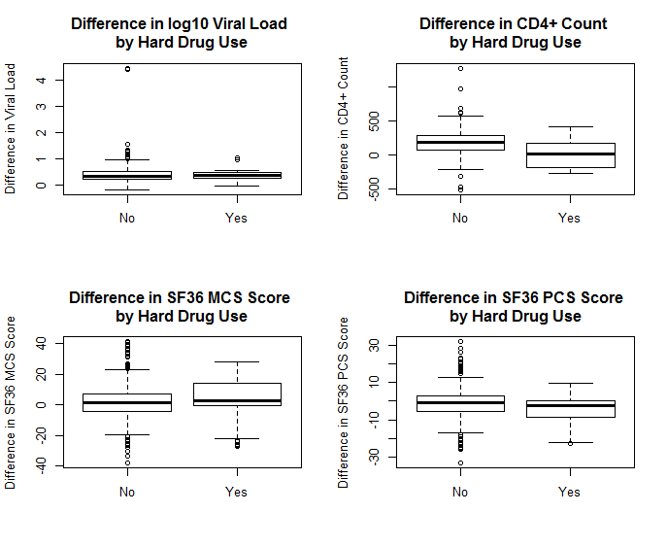
Outcomes

Slide 4
Bayesian framework analysis
Linear regression for each outcome (difference from baseline to 2 year mark)
PROC MCMC, random walk Metropolis-Hastings algorithm, starting values of 0 for parameters and 1 for variance
Vague/uninformative priors
Parameters: ~normal(mean = 0, variance = 1000)
Error: ~inverse gamma(shape = 2.001, scale = 1.001)
Intercept and drug use in CD4+ model: ~normal(mean = 0, variance = 10000)
DIC used to compare full model and model with one covariate removed at a time
Model was tested without alcohol consumption, smoking status, marijuana use, and education or income
Final model removed all covariates that improved DIC when removed

